Slide 1
Management by objective

Slide 2
Definition
Management by Objectives (MBO) is a personnel management technique where managers and employees work together to set, record and monitor goals for a specific period of time.
Organizational goals are translated into personal goals
Peter Drucker
1960s.

Slide 3
Need for MBO
Clarity
Job satisfaction
Avoid confusion
Achievement of organizational goal
Well defined role
Low employee turnover
Effective communication
Positive ambience at the workplace.
Well defined hierarchies at the workplace.
Transparency
Highly motivated and committed employees.
Sets a benchmark for every employee.

Slide 4
Assumption
People tend to perform better when they are known about what is expected from them and when they can associate their personal goals with that of the objectives of the organization.

Slide 5
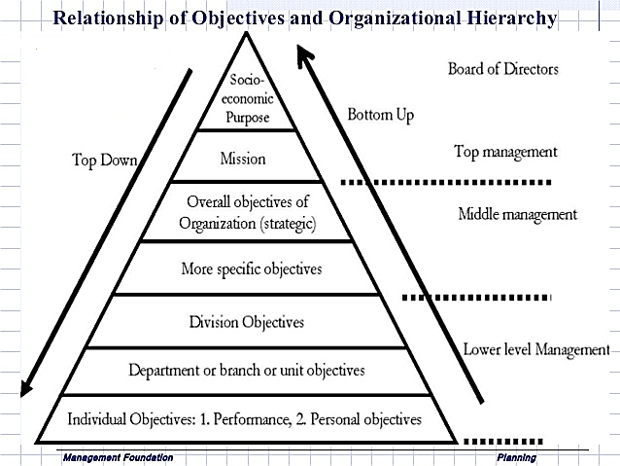

Slide 6
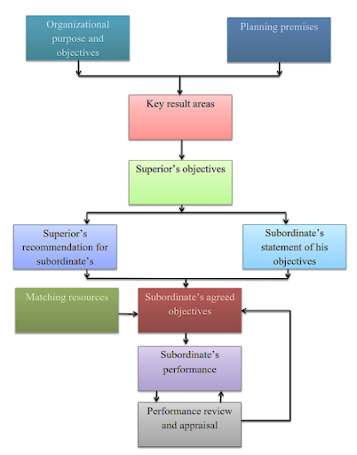
Process of MBO

Slide 7
Benefits of MBO
Better Management
Resources are put in such manner that they result into better performance.
Better management by clarity in objectives, role clarity, periodic feedback of performance, participation by managers in the management process, realisation that there is always scope for improvement, etc…
Clarity in Organizational action
It provides Key Result Area(KRA) where organizational efforts are required

Slide 8
Benefits of MBO
Personal Satisfaction
This is because of two closely related phenomena:
(1) Participation in objective setting
(2) Rational performance appraisal.
Basis for Organizational Change
MBO stimulates the changes, and provides a framework and guidelines for planned change, enabling management to initiate, plan, direct and control the direction and speed of change.

Slide 9
Limitation of MBO
Time and Cost
It is not as simple as it looks to be.
It requires large amount of scarce resources like time of senior managers
It is something over and above some normal work
It also generates paper work as so many forms are need to be filled by both.
It creates only in the initial phase of MBO and organization over a period of time it may be disappear.
Failure to teach MBO philosophy
Managers fail to understand and appreciate the new approach by creating doubt in their mind like –
What purpose it served by MBO?
How the performance is to be appraised?
How organization will benefit?

Slide 10
Limitation of MBO
Problems in objective setting
It requires objective must be set out in verifiable terms, against which performance can be measured.
It is again difficult to set in at least some of the area like innovation, technology, etc…
Emphasis on short term objectives
It is very well suitable and dealt with short term objective its preciseness around for a year or even less.
It is danger to emphasis on short term objectives at the cost of long term objectives.

Slide 11
Limitation of MBO
Inflexibility
In a dynamic environment, a particularly objectives may not be valid forever. In the context of revised objectives, changed premises or modifies policies, it is useless to follow old objectives.
However, many managers often hesitate to change objectives during a period of time. Thus, inflexibility can really cause harm to the organization.
Frustration
It may be because of two reasons:
As lack of experiences, many organization could not implement MBO properly.
Introduction to MBO tends to arouse high expectations for rapid change particularly among young junior managers in terms of organizations growth, profitability and in themselves in their career advancement. If rate of changes is slower than expected due to any reason, managers begin to feel frustration.

